Slide 1
Poverty in the United States BIA 652 Final Project
Vijay Sarathy
07/26/2015

Slide 2
Objectives
Determine is poverty differs among counties in the Unites States
Examine the role of Urban-ness and rural-ness
Dataset: Independent Variables: 2013 Urban-ness, rural-ness, household size, population, unemployment rate, completion rate of high school; Dependent Variables: poverty rate, median income
Methods: Examining Data, Factor Analysis, Multiple Regression

Slide 3
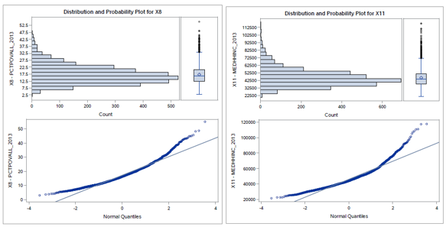

Examining the Data
The dependent variables X8, X11 are skewed
Most of the values have significant Shapiro-Wilk values meaning that the data is asymmetric.

Slide 4
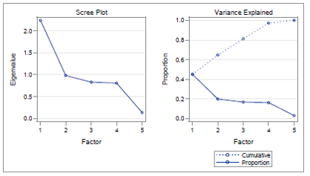
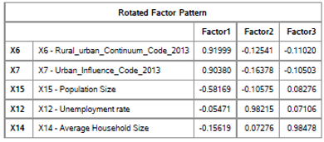
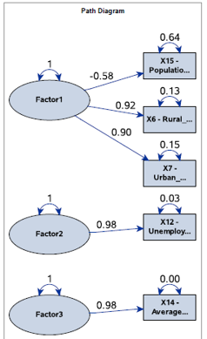
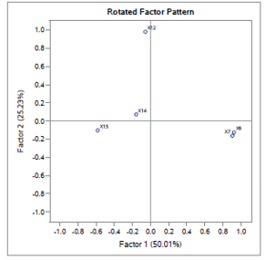
Factor Analysis
Varimax rotation achieved the best representative solution.
Factors 1, 2 are shown to be influential.

Slide 5
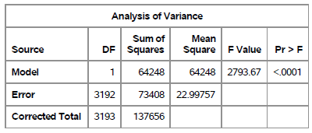
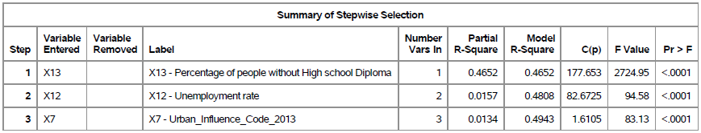
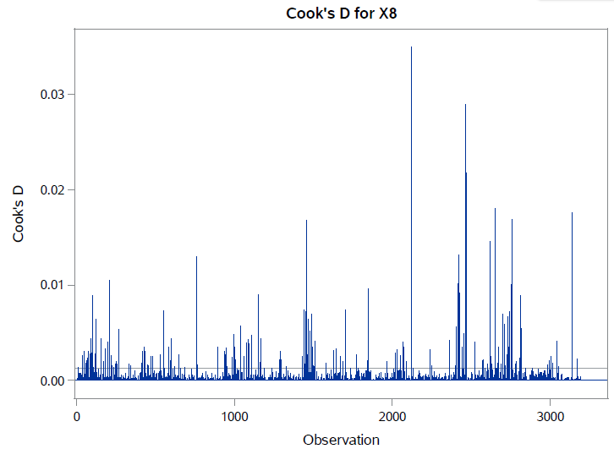
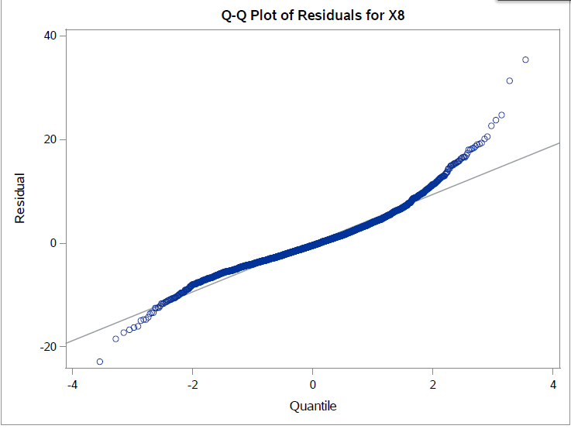
Multiple Regression
X8, the overall poverty rate has many significant observations, the center portion of the data is normally distributed
Stepwise regression yielded X13, X12, X7 as the significant variables at the 0.05 level

Slide 6
Conclusions
Poverty rate does differ based on county
Factor analysis shows that one factor influences Urban-ness , Rural-ness and population size
Regression shows that high school incompletion, unemployment,
and urban-ness, are correlated with poverty.

